Slide 2
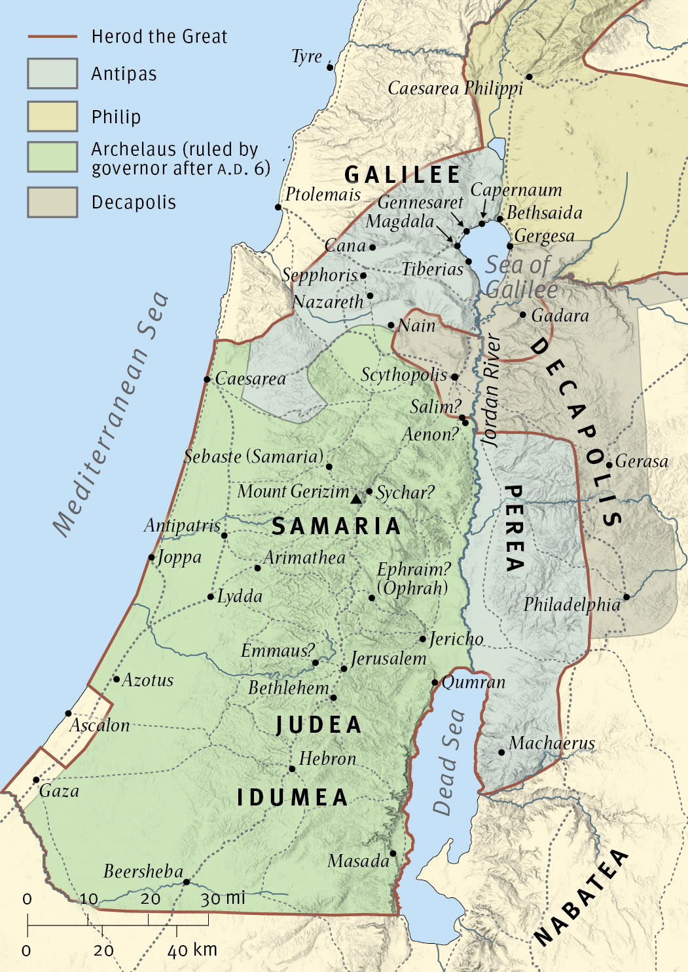
Herod’s Lands: Galilee and Perea
Machaerus

Slide 4
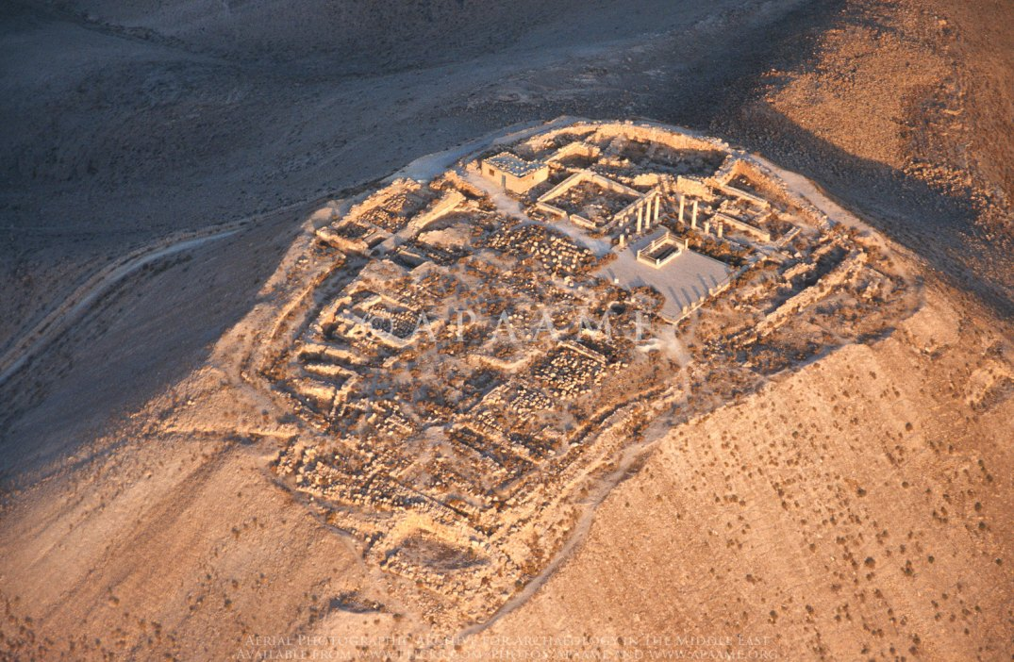
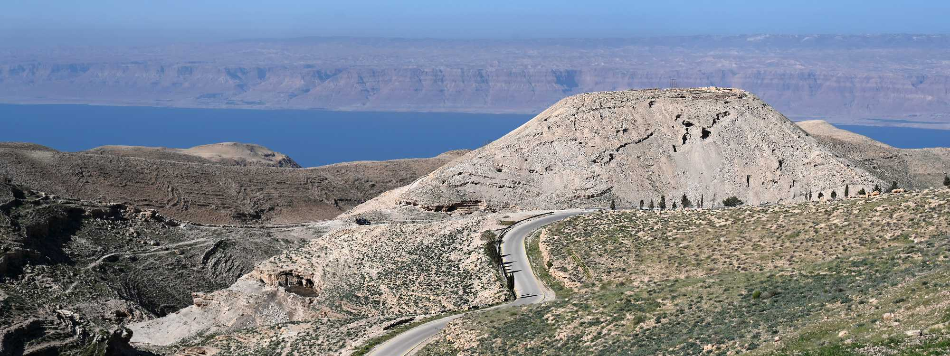
Machaerus- Herod’s Fortress

Slide 5
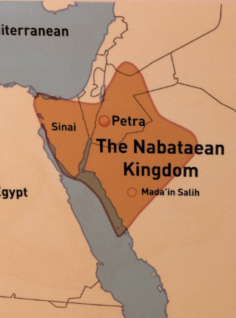

Slide 6
Timeline of Herod and John
AD 27- Herod Antipas marries Herodias
AD 29*- John Begins Ministry
AD 30*- John Imprisoned
AD 30-31*- John Beheaded
AD 33*- Herod tries Jesus
AD 36- Herod Defeated by Nabateans
AD39- Herod deposed
AD 39+- Herod dies in S. France

