Slide 1
Noah & the Ark
Genesis 6:9-22

Slide 2
A righteous man
vv. 9-10

Slide 3
Noah
Righteous (just)
Blameless (complete)
Walked (fellowship)

Slide 4
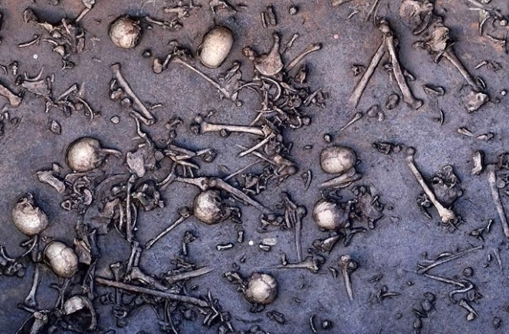
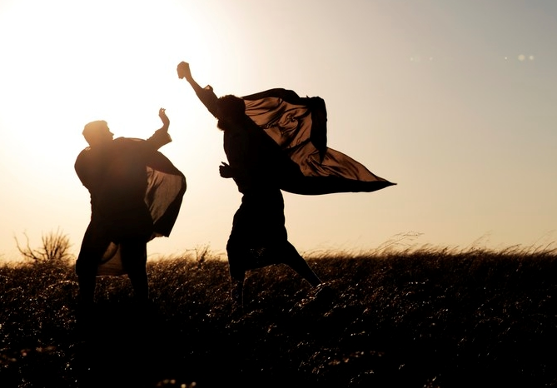
The Earth’s Corruption (v.v.11-12)
We are good, we do good, God accepts us and all go to heaven.
We are sinners, we sin, God rejects us, we all go to hell.
Pronouncement (vv. 13 & 17)

Slide 5
How did noah escape?

Slide 6
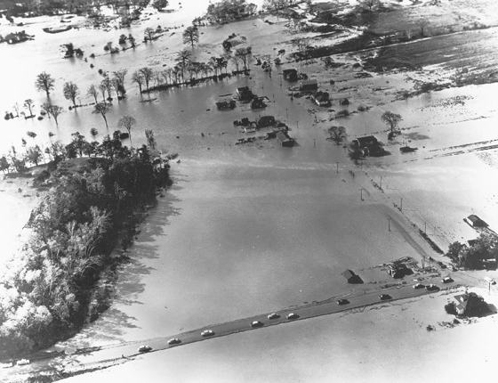
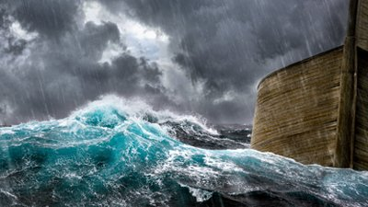
Local or Global?

Slide 7
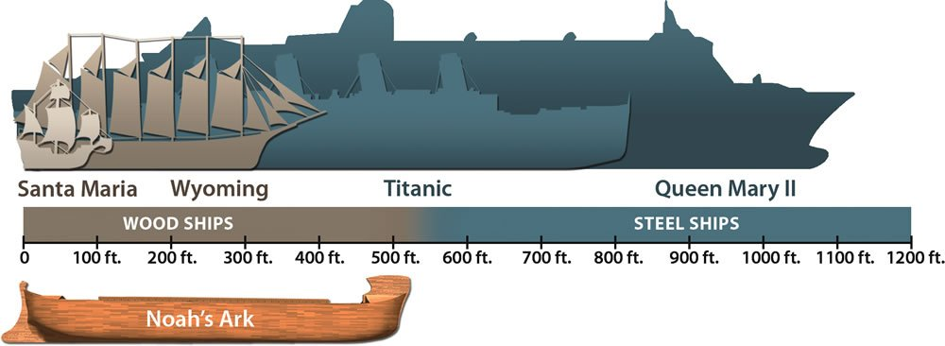
Could Noah really have built a ship that big?

Slide 8
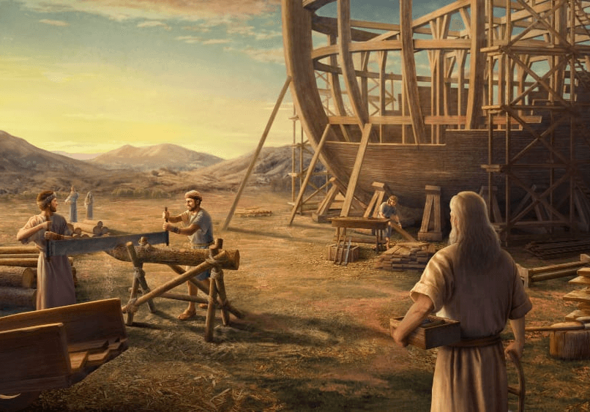
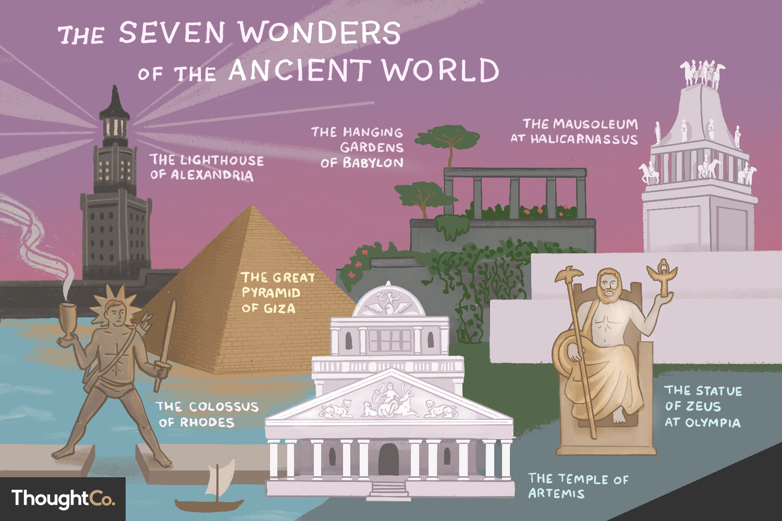
Could Noah really have built a ship that big?

Slide 9
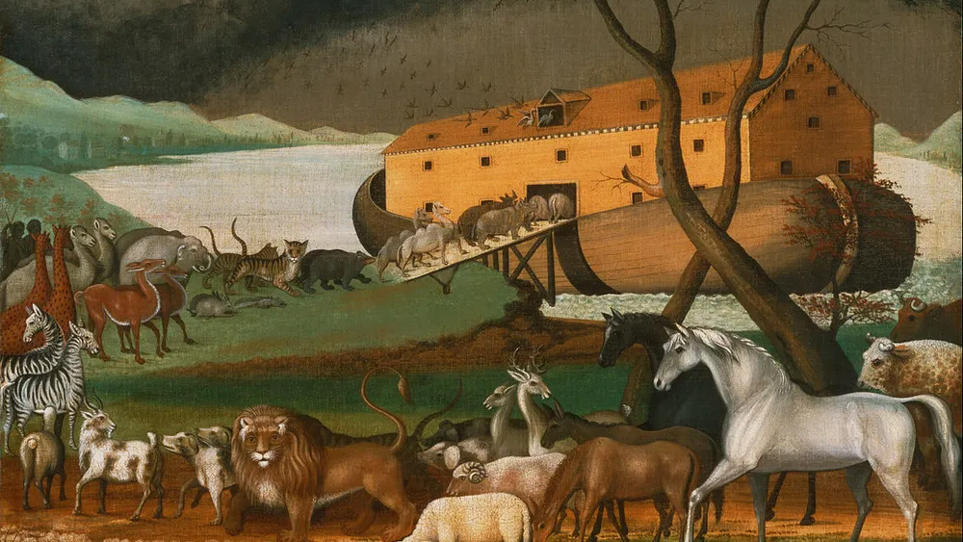
How Could all the animals fit?

Slide 10
Noah, preacher of righteousness (2 Pet 2:5)

Slide 11
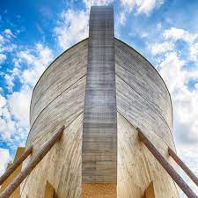
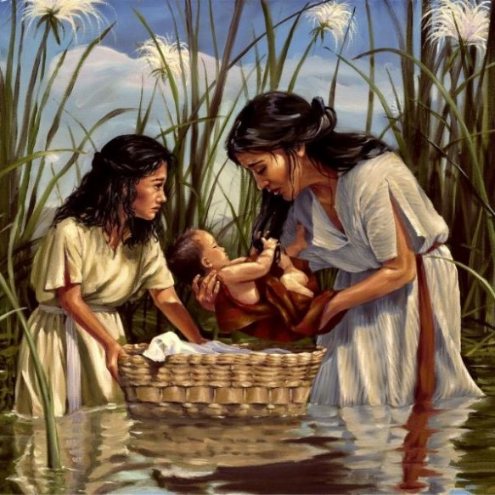
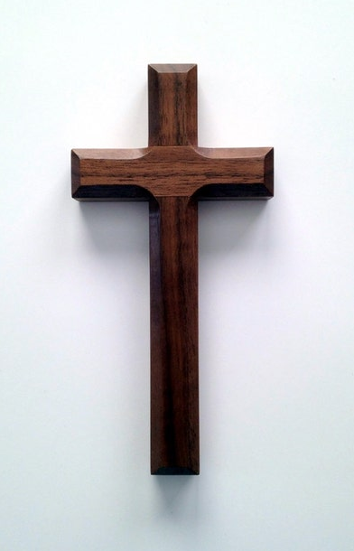
Pact and provision: takeaway

