Slide 1
Noah and the flood
Genesis 7-8

Slide 2
Have you ever experienced a flood?

Slide 3
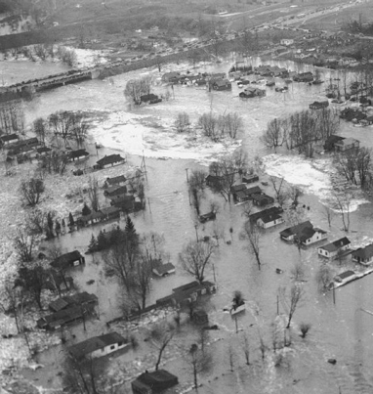
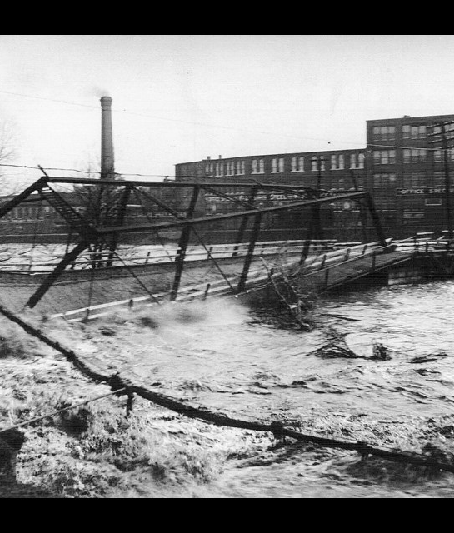
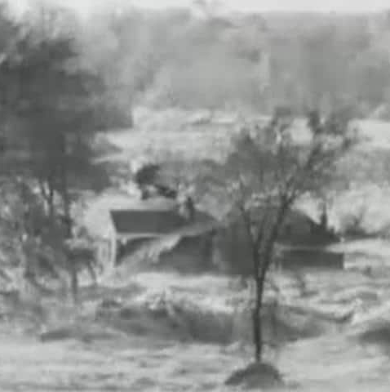
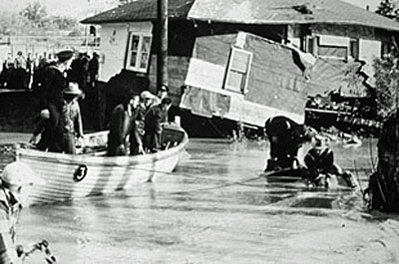
Hurricane Hazel, Toronto (1954)
7” and 16’
20+ bridges destroyed
7500 homeless
300 lives lost

Slide 4
OUTLINE
A Global Flood?
370 Days in the Ark
Takeaways

Slide 5
A Global Flood?

Slide 6
REASON: TOTAL DESTRUCTION
What verses in chapter six give us the reason?
What echoes from Genesis 1 speak of “de-creation”?
Why do you think Genesis places such emphasis on the Flood?

Slide 7
Uniformitarianism vs catastrophism?
Uniformitarianism
Catastrophism
The Present is key to the past
Geology is evidence of millions of years.
The past is the key to the present
Geology is evidence of a global flood.
CREEK

Slide 9
5 Reasons FOR catastrophism
The best explanation of the present.

Slide 10
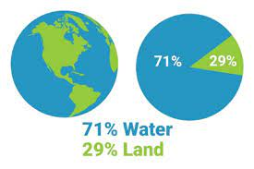
1. Water (c.f. Ps 104:8-9)

Slide 11
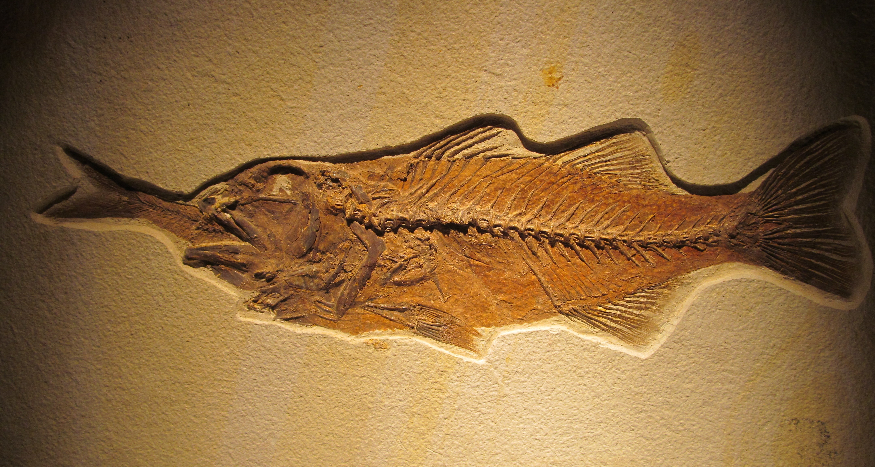
2. Fossilization of live creatures?

Slide 12
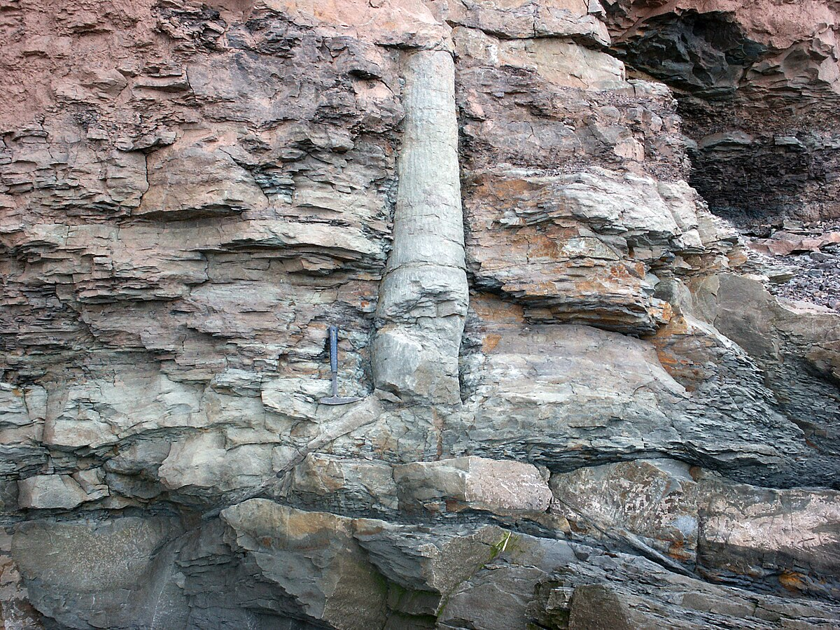
3. Fossils cross layers

Slide 13
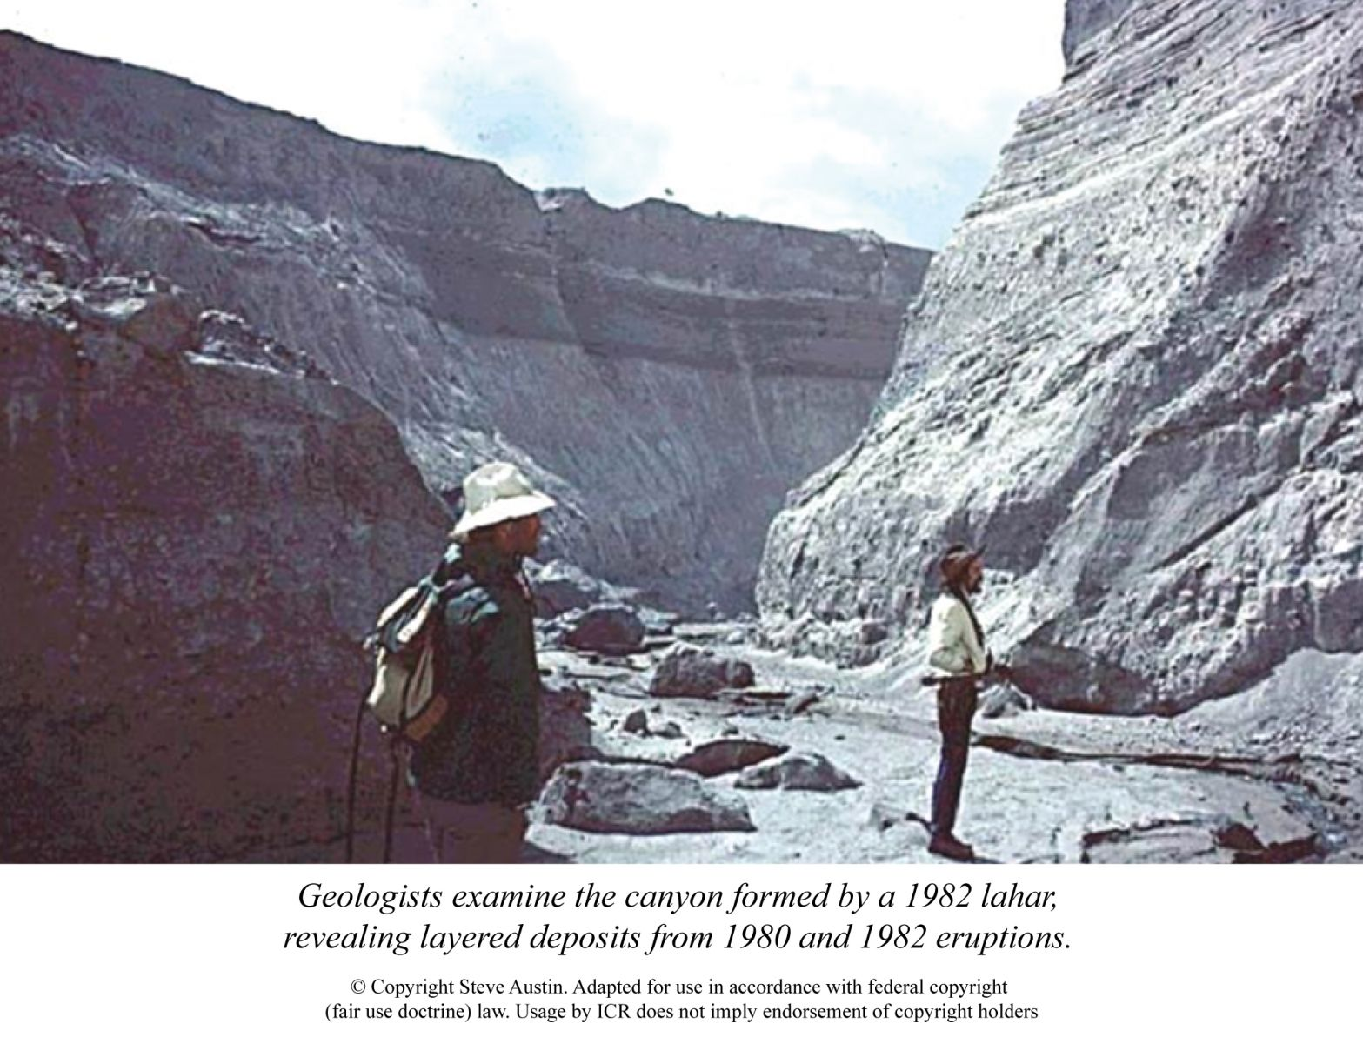
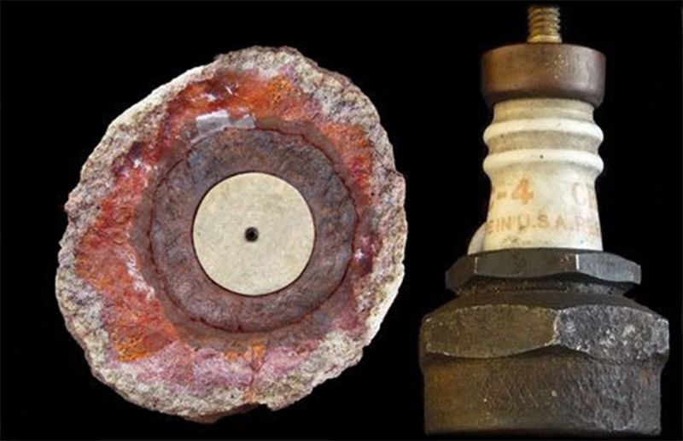
4. Rocks and fossils can be recent

Slide 14
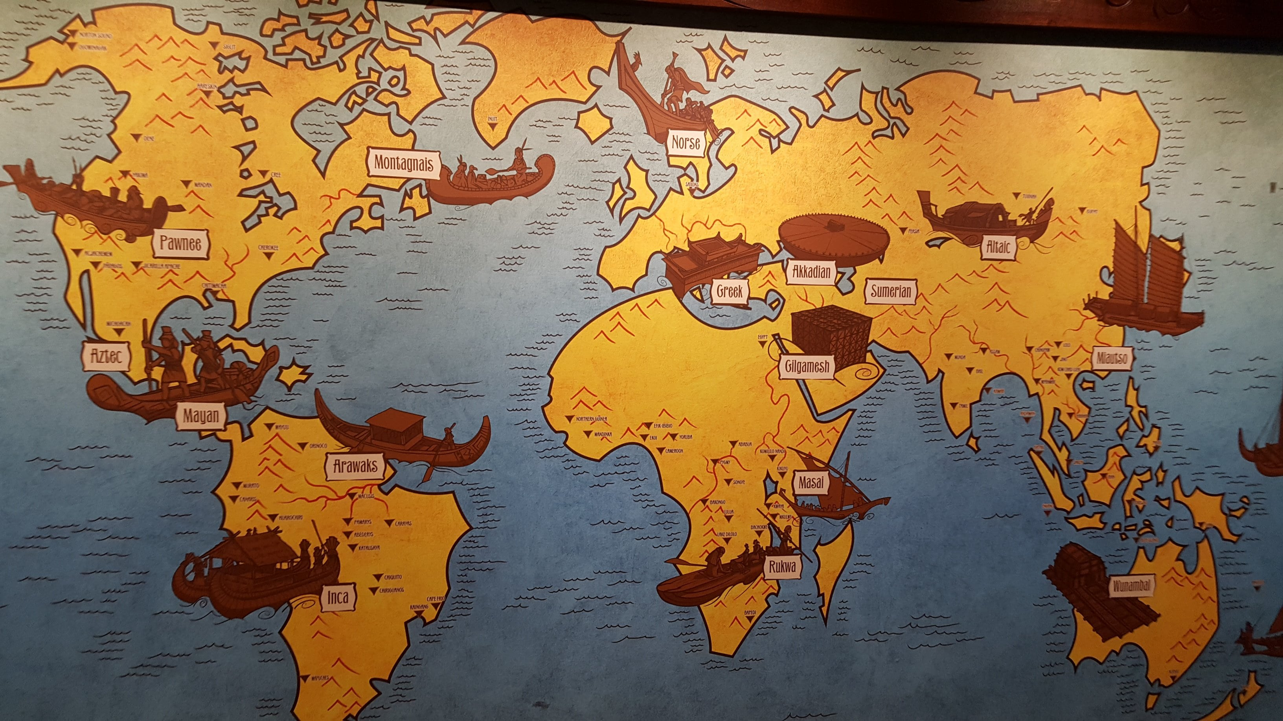
5. Flood stories

Slide 15
370 Days on the Ark

Slide 16
How we get 370 days…

Slide 17
Imagine life Outside of the Ark…

Slide 18
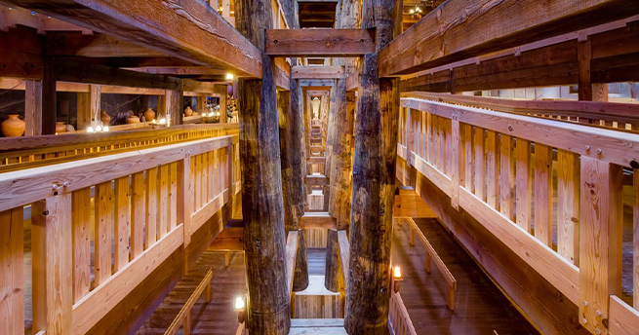
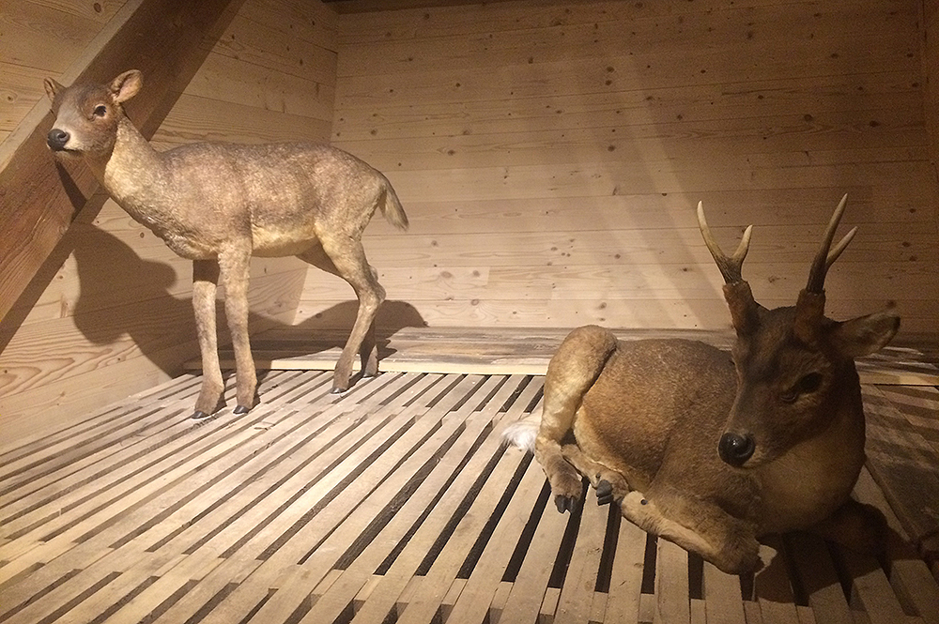
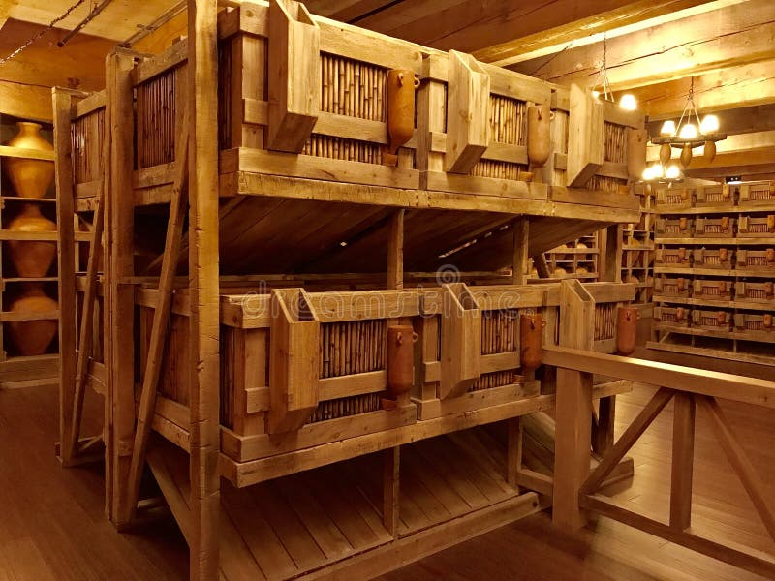
Imagine life iNSIDE the Ark…

Slide 19
Takeaways

Slide 20
Baptism
“Baptism, which corresponds to this, now saves you, not as a removal of dirt from the body but as an appeal to God for a good conscience, through the resurrection of Jesus Christ,” (1 Peter 3:21)

